Slide 1
The Future Perfect Tense

Slide 2
Questions
Question 1 Question 6
Question 2 Question 7
Question 3 Question 8
Question 4 Question 9
Question 5 Question 10

Slide 3
Question 1
We can move the piano in the house next week. It ______ ______ _____ on Sunday.
will have arrived
would had arrived
will had arrived
will having arrived

Slide 4
Question 2
The train ________ _______ _______ the station when Joe gets there
would had left
would had leaving
will have left
will having left

Slide 5
Question 3
You can touch the gate tomorrow. The paint _______ _____ ______ by then
will had dried
will had dried
will have drying
will have dried

Slide 6
Question 4
I _______ _____ ______ my work before Mary arrived.
will had finished
will have finished
will have finishing
will had finished

Slide 7
Question 5
Raju ____ ____ _____ the rambutan tree by the time his parents returned
would had climb
would had climbing
will have climbed
will having climbed

Slide 8
Question 6
By the time the treasure hunts begins, Pat ____ ____ _____ all the clues
would had hid
will have hidden
will have hiding
will having hid

Slide 9
Question 7
Johan ____ ____ ____ his homework before Syafiq arrives.
will have done
would had done
will have doing
will having done

Slide 10
Question 8
Johan ____ ____ ____ his homework before Syafiq arrives.
will have done
would had done
will have doing
will having done

Slide 11
Question 9
The maid ____ ____ ____ the house before the guest arrived
will having cleaned
would had cleaned
will had cleaning
will have cleaned

Slide 12
Question 10
James and Samantha ____ ____ _____ a house before they left for Kuala Lumpur.
will have buy
will have bought
will have buying
will having bought

Slide 13
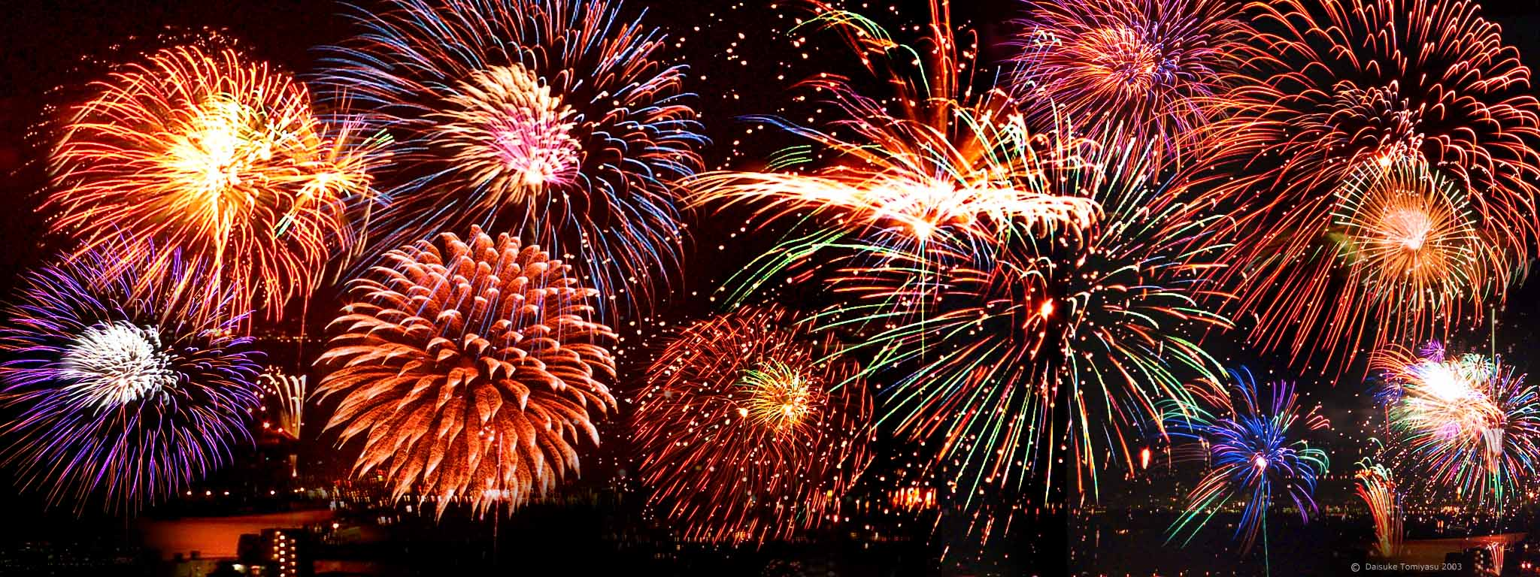
CONGRATULATIONS YOU ARE RIGHT!
BACK

Slide 14
CONGRATULATIONS YOU ARE RIGHT!
NEXT

Slide 15
PLEASE TRY AGAIN!
BACK

