Slide 1
The Present Perfect Tense

Slide 2
Questions
Question 1 Question 6
Question 2 Question 7
Question 3 Question 8
Question 4 Question 9
Question 5 Question 10

Slide 3
Question 1
I ______ _______ him already.
have seen
will see
has seen
have see

Slide 4
Question 2
Johnny and James ______ _____ to school.
have going
have gone
has going
had going

Slide 5
Question 3
Aminah _____ ______ the room cleanly.
has sweeping
has sweep
has swept
had sweep

Slide 6
Question 4
_____ you seen the movie “The Hobbits 2”
Having
Had
Has
Have

Slide 7
Question 5
We _____ _____ the movie “The Hobbits2”.
has enjoyed
have enjoyed
having enjoying
have enjoy

Slide 8
Question 6
Mastura ____ _____ many books.
have reading
have read
has read
had read

Slide 9
Question 7
Selvaraj _____ ______ me a present for my birthday.
had buy
has bought
have bought
has buying

Slide 10
Question 8
They ____ _____ their clothes already
have wash
had washing
has washed
have washed

Slide 11
Question 9
We ____ ____ the wedding planners.
have seen
had seeing
has saw
has seen

Slide 12
Question 10
He ____ ____ me for years.
had know
has known
have know
have knowing

Slide 13
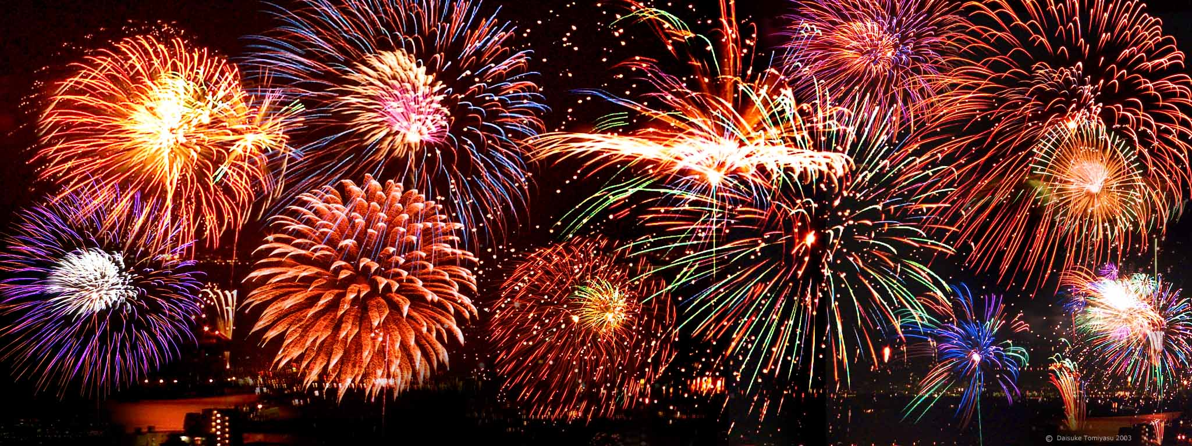
CONGRATULATIONS YOU ARE RIGHT!
BACK

Slide 14
CONGRATULATIONS YOU ARE RIGHT!
NEXT

Slide 15
PLEASE TRY AGAIN!
BACK

